Slide 1
Laptop Price Prediction
Author Name: Xue Liu

Slide 2

Laptop Price Prediction
The Laptop Price dataset is a collection of laptop product listings scraped from an online e-commerce website. The dataset includes information about various laptop models, such as their brand, screen size, processor, memory, storage capacity, operating system, and price. However, the dataset is uncleaned, it contains missing values, inconsistent formatting, and other errors that need to be addressed before the data can be used for analysis or modelling.
The dataset contains both categorical and numerical variables, with the majority of variables being categorical, including brand, model name, screen resolution, processor type, and operating system.
Some numerical variables include screen size, memory, and storage capacity.
The target variable in the dataset is the price, which is a continuous variable.

Slide 3
Data Preprocessing
58
01
12
Duplicate Data
Missing Value
Outliers

Slide 4
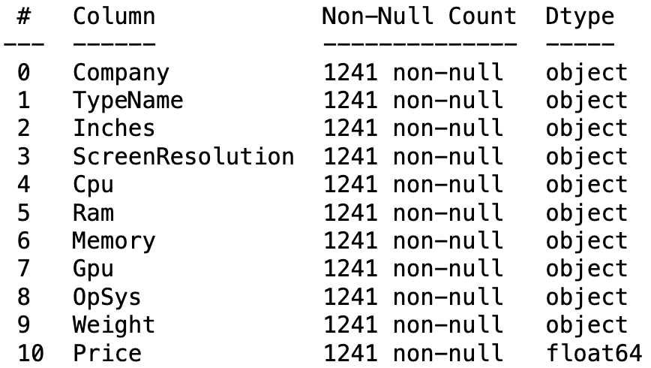
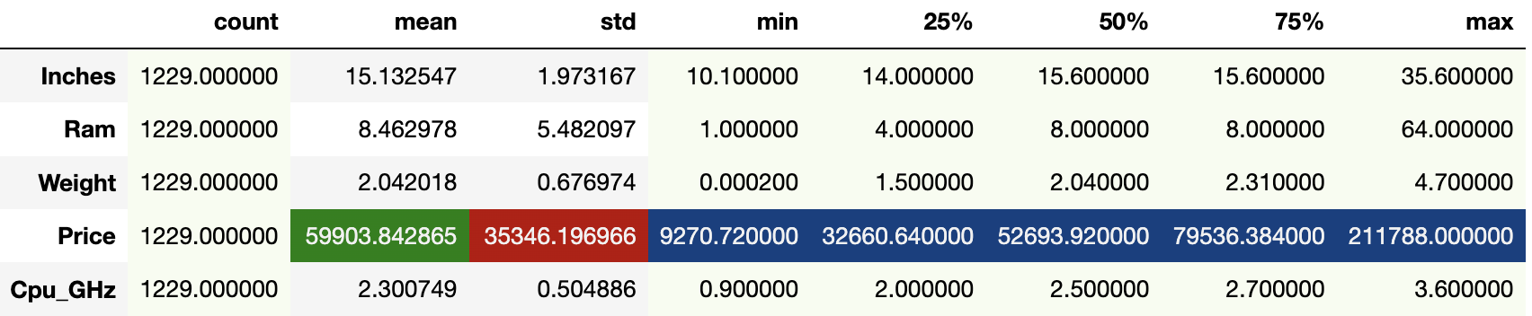
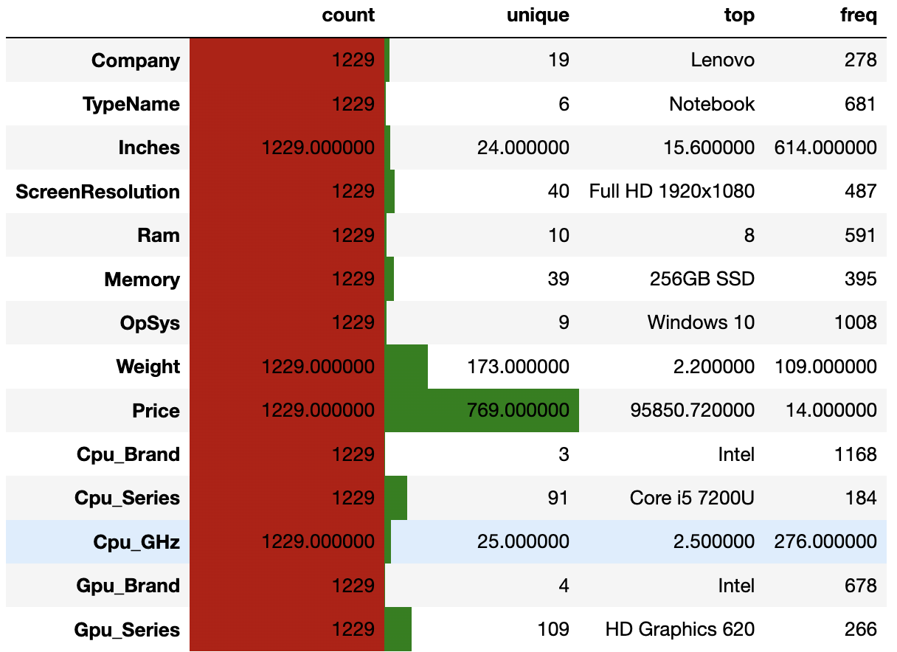
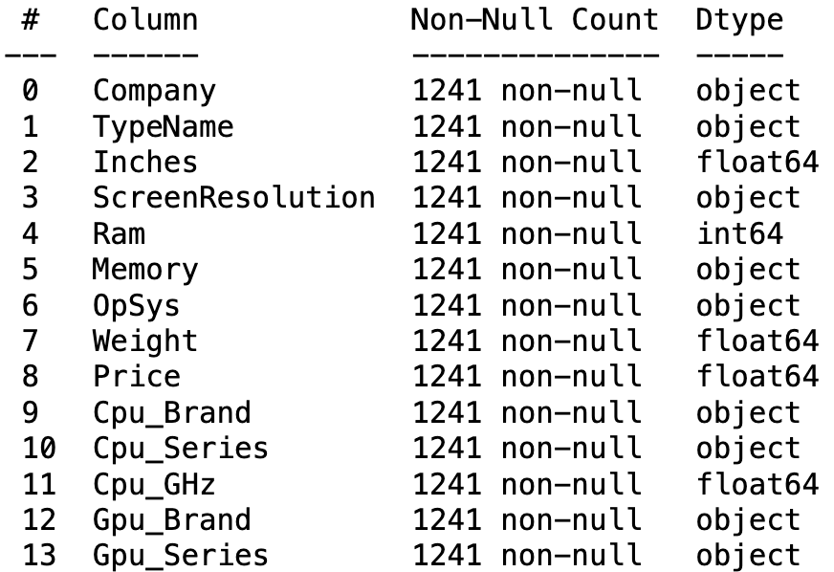
Standardise Values

Slide 5
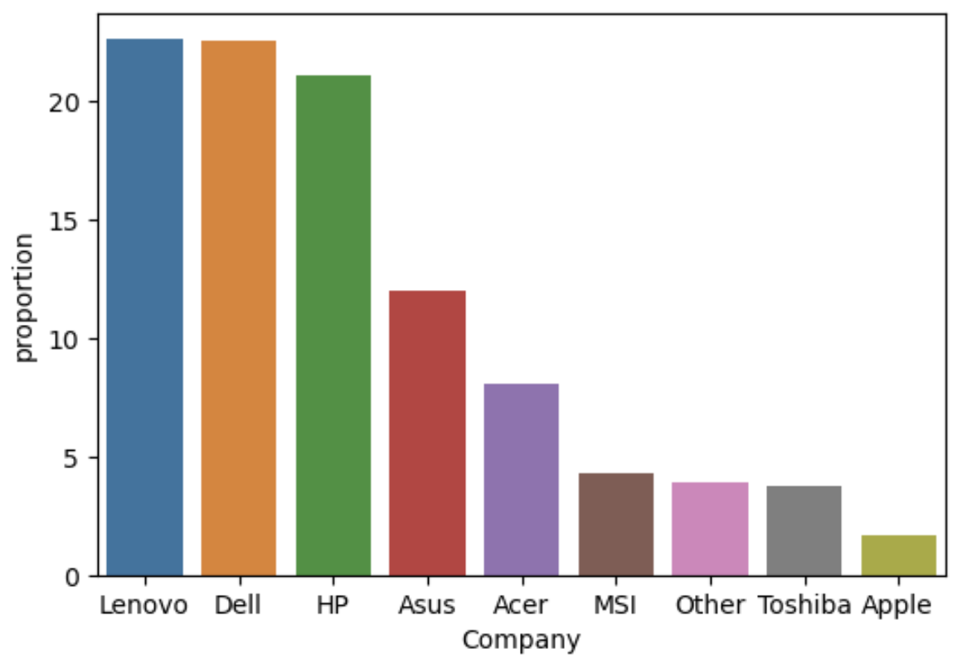
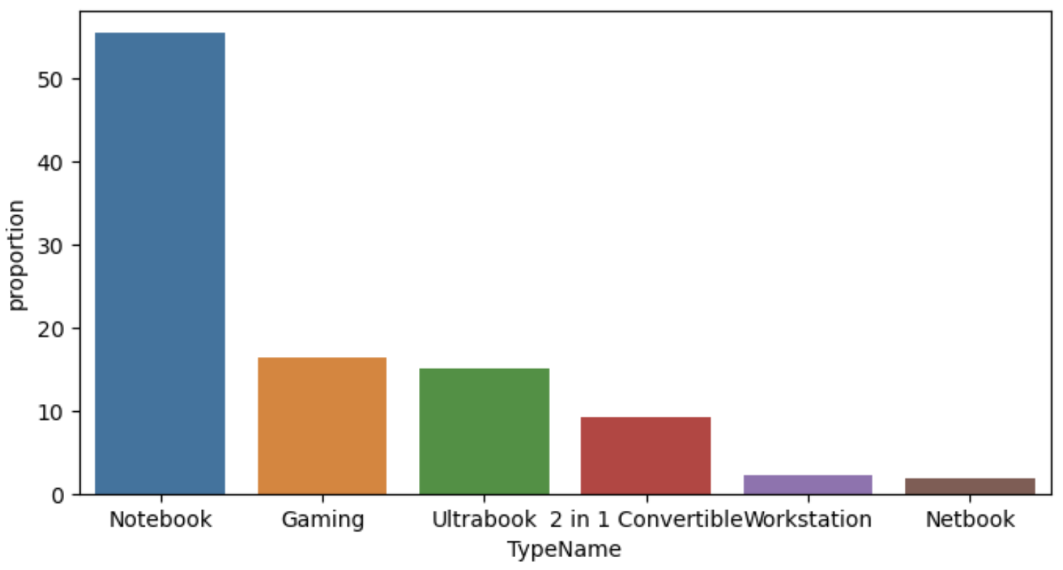
Exploratory Data Analysis
Notes:
The top 3 companies are Lenovo, Dell, Hewlett-Packard, they have similar proportions. The proportion of the top 3 companies combined is 66% of the total. Head companies lead the mainstream market
The most popular type of laptop is notebook. The proportion of Notebook is more than the other five types combined. The market share of notebooks far exceeds that of other types of laptop, and it has an absolute advantage

Slide 6
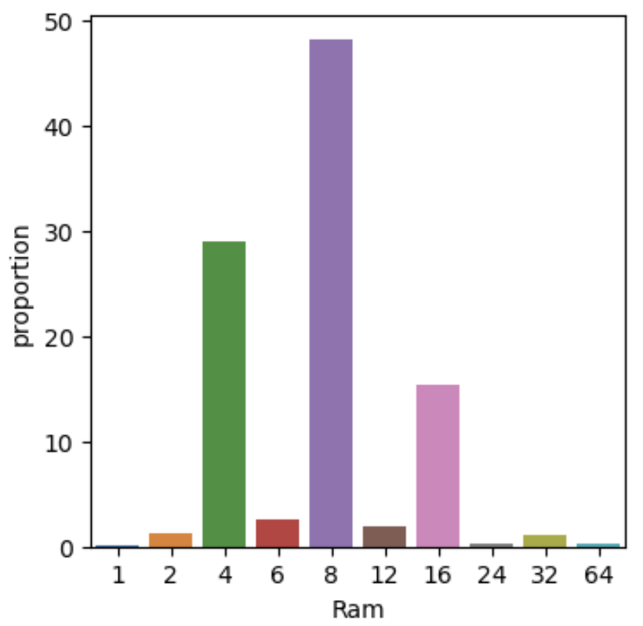
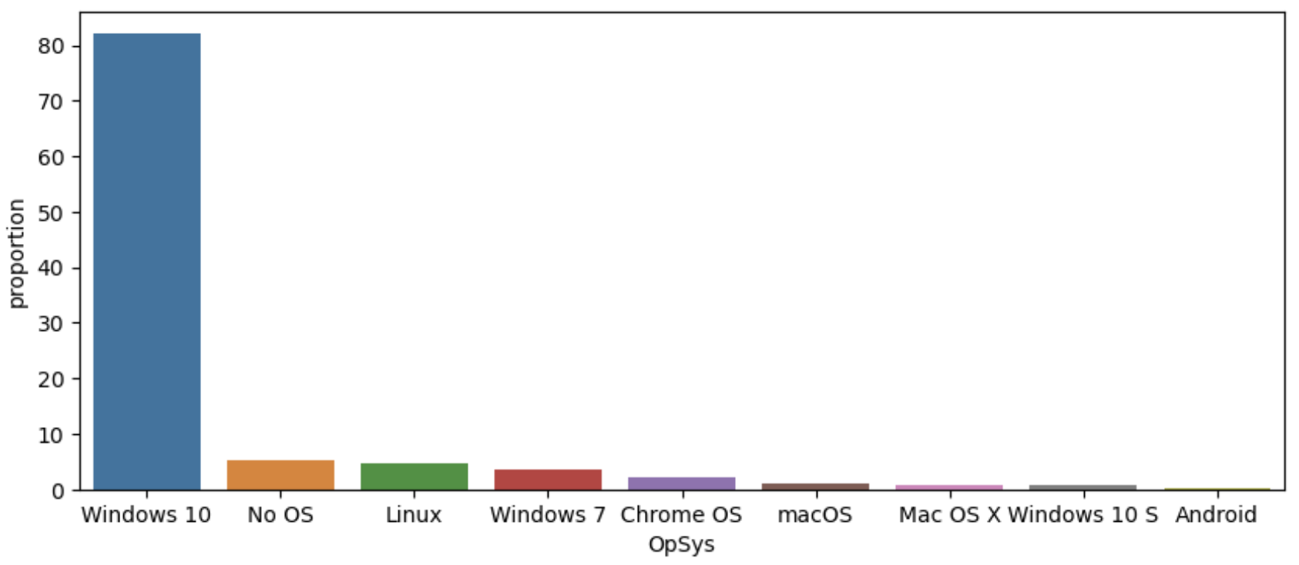
Exploratory Data Analysis
Notes:
The proportion of Ram(Random Access Memory) with 8GB is nearly half of the total. The top 3 combined accounting for 92% of the total. 4 GB, 8GB and 16GB occupy almost the entire market.
The most popular operating system is Windows 10. The proportion of Windows 10 is more than 80%, dominating the market.

Slide 7
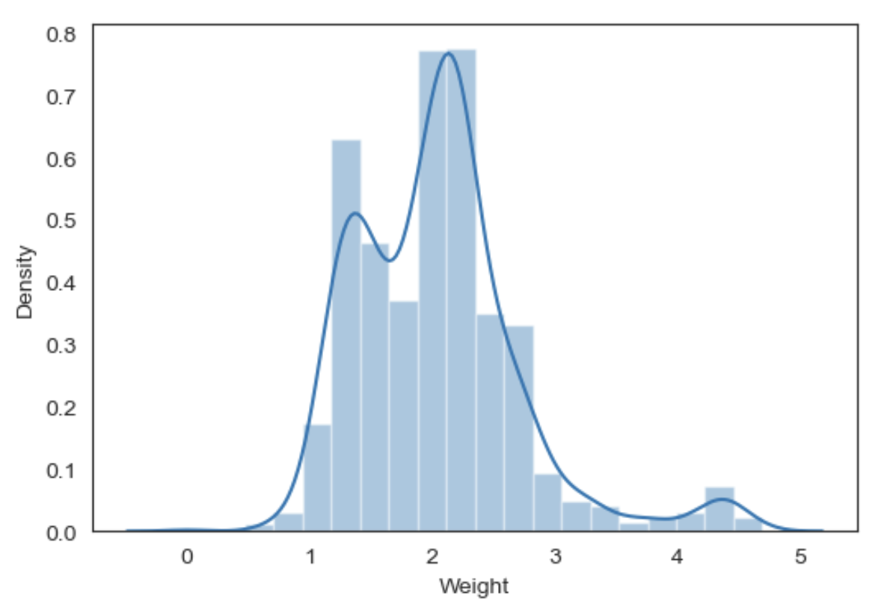
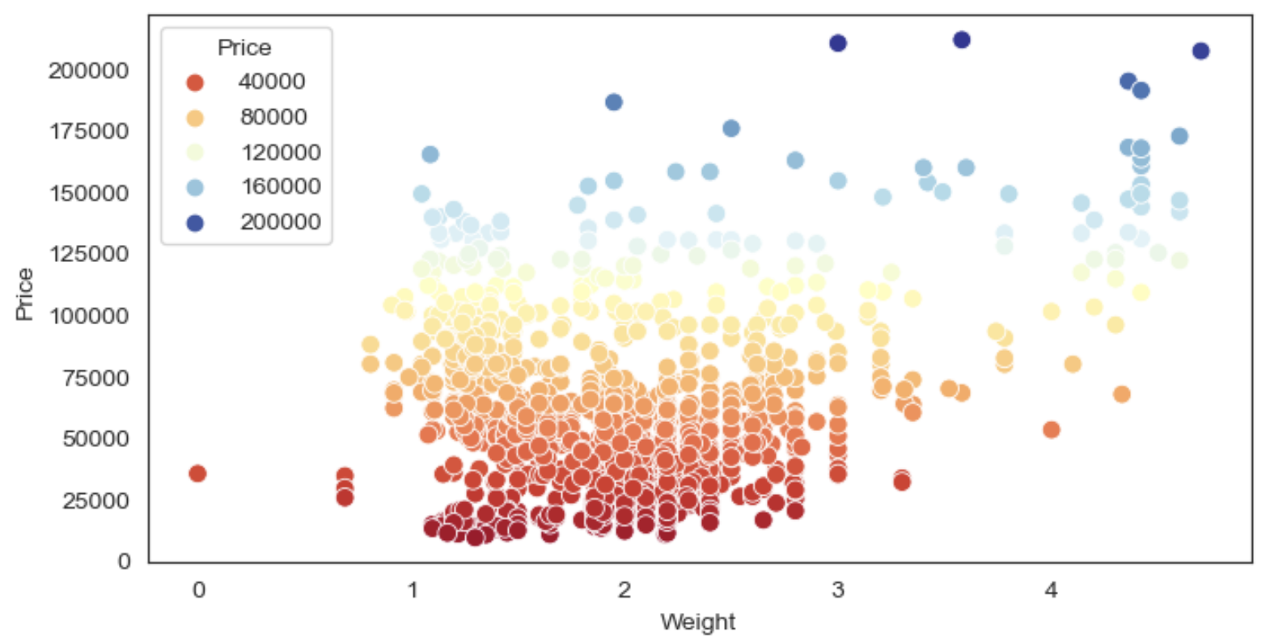
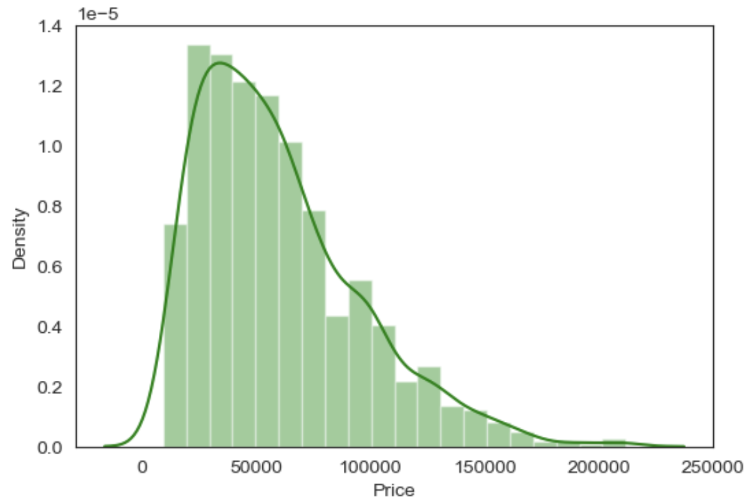
Exploratory Data Analysis
Notes:
Laptops weighing less than 3 kilograms have lower prices and larger quantities. The lightweight laptops are of cheaper price. The number is concentrated on lightweight laptops, which proves that consumers prefer lightweight laptops. At the same time, lower-priced laptops are more easily accepted by consumers.

Slide 8
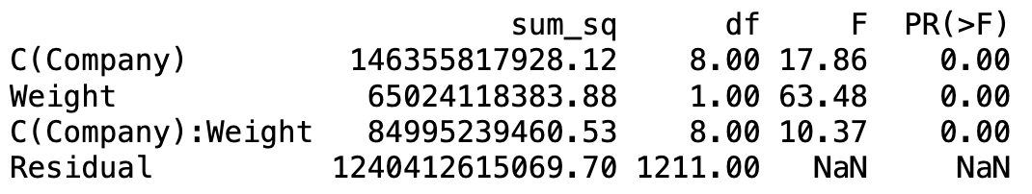
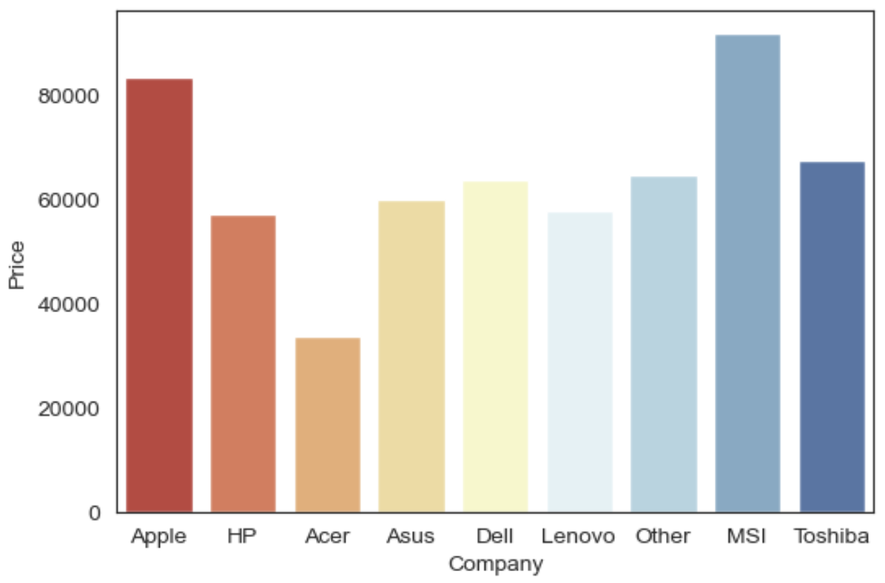
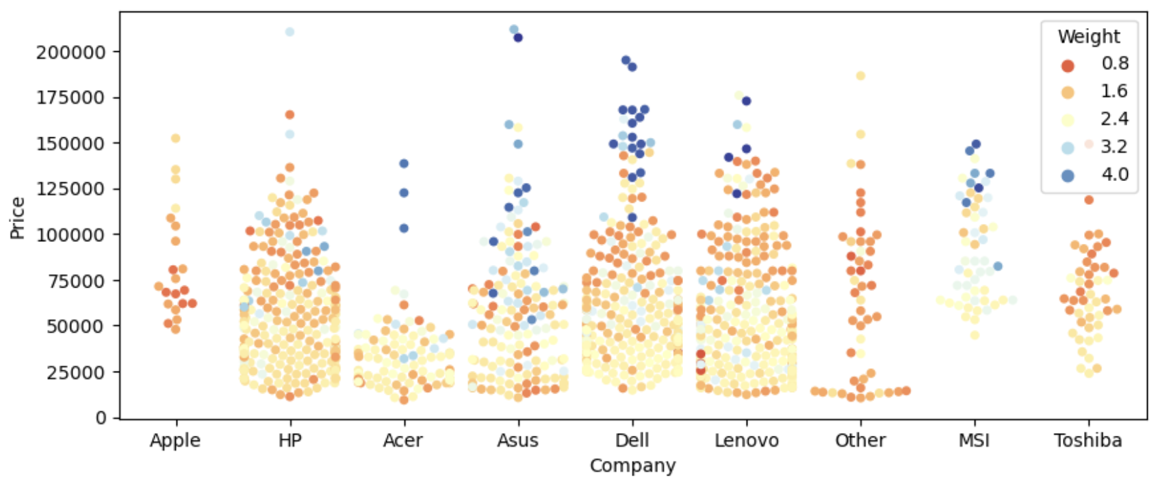
Exploratory Data Analysis
Notes:
Hewlett-Packard, Asus, Dell, and Lenovo have a wide range of laptop pricing, covering low-price laptops and high-end laptops. At the same time, the weight range of these 4 companies is also wide, including lightweight laptops and heavier laptops. Consumers tend to own lightweight laptops with lower prices. At the same time, mainstream laptop companies also tend to expand the weight range and price range in order to adapt to various consumer groups.
I run Multi-variate Analysis to perform Hypothesis Testing on these three variables to determine whether there is a relationship between the three
All the p-values are close to zero which indicate that the effects of Company, Weight, and the interaction between them on Price are all highly significant

Slide 9
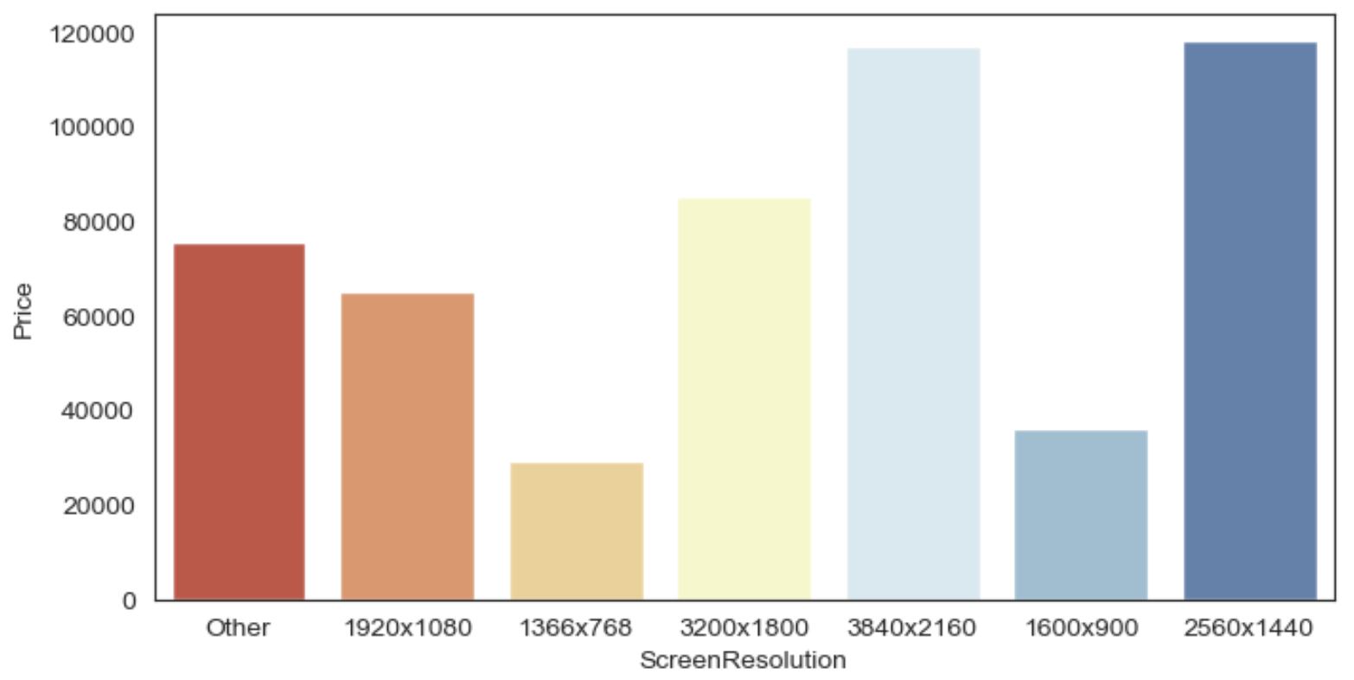
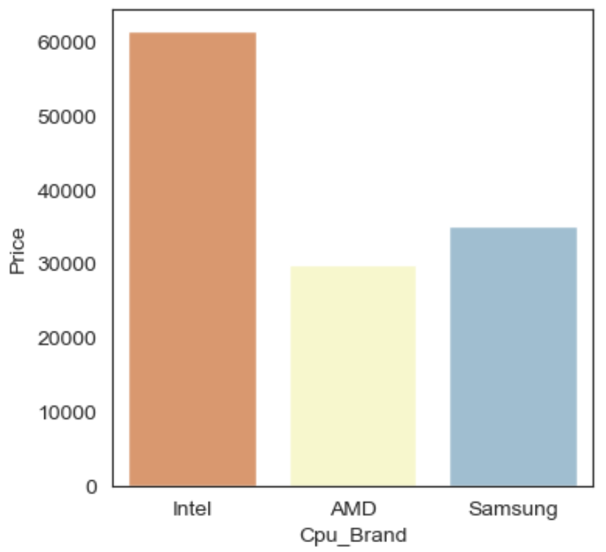
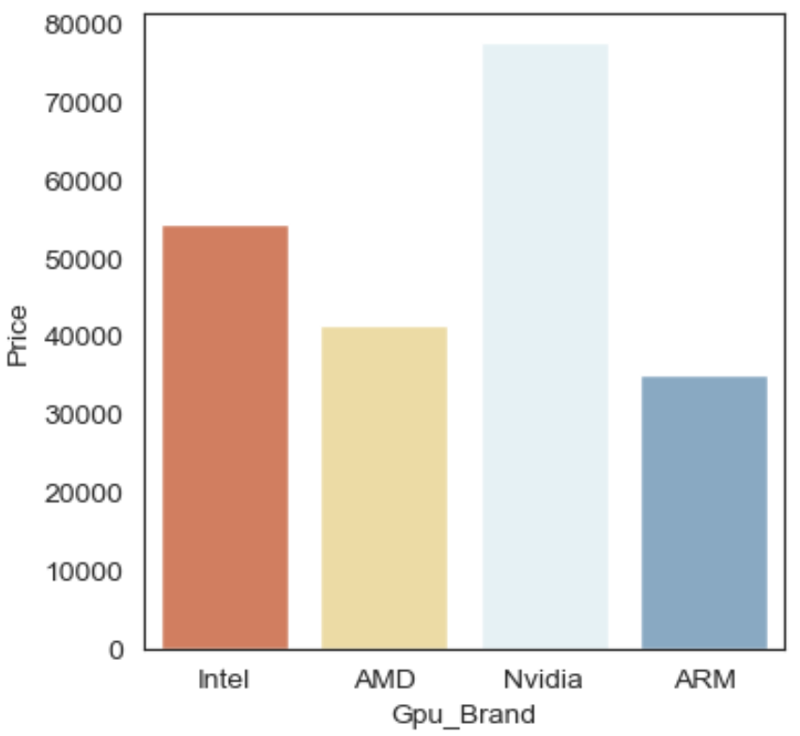
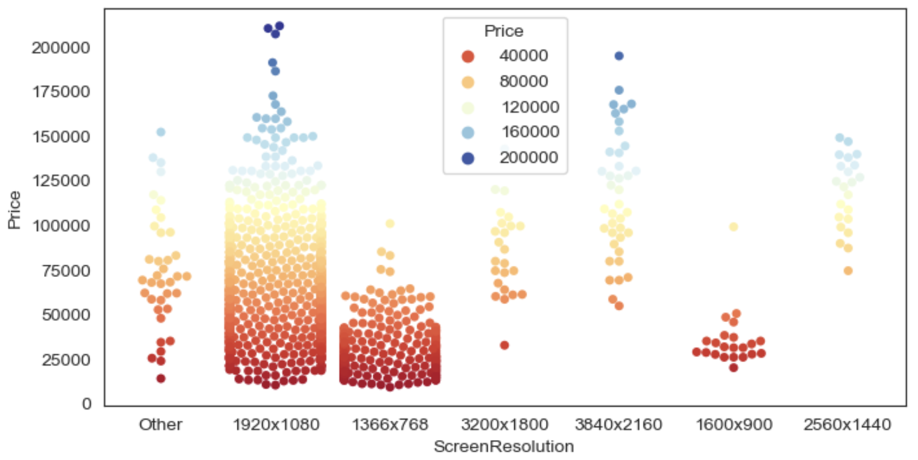
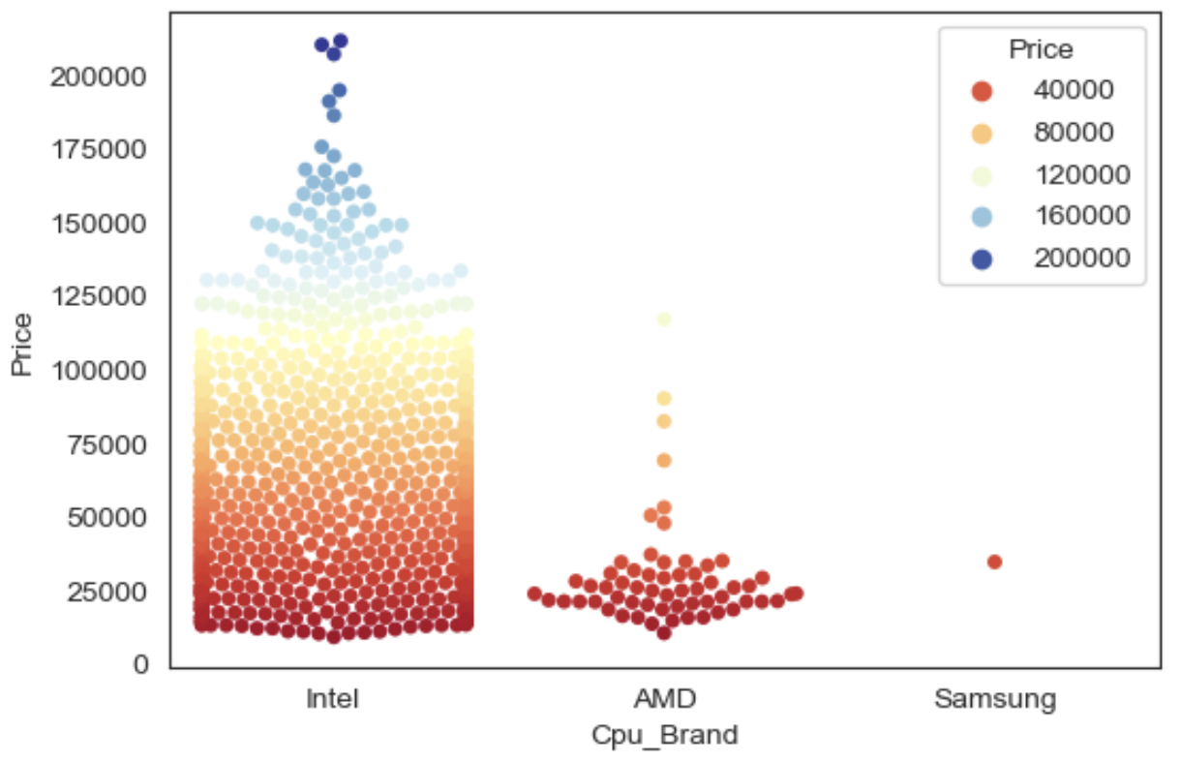
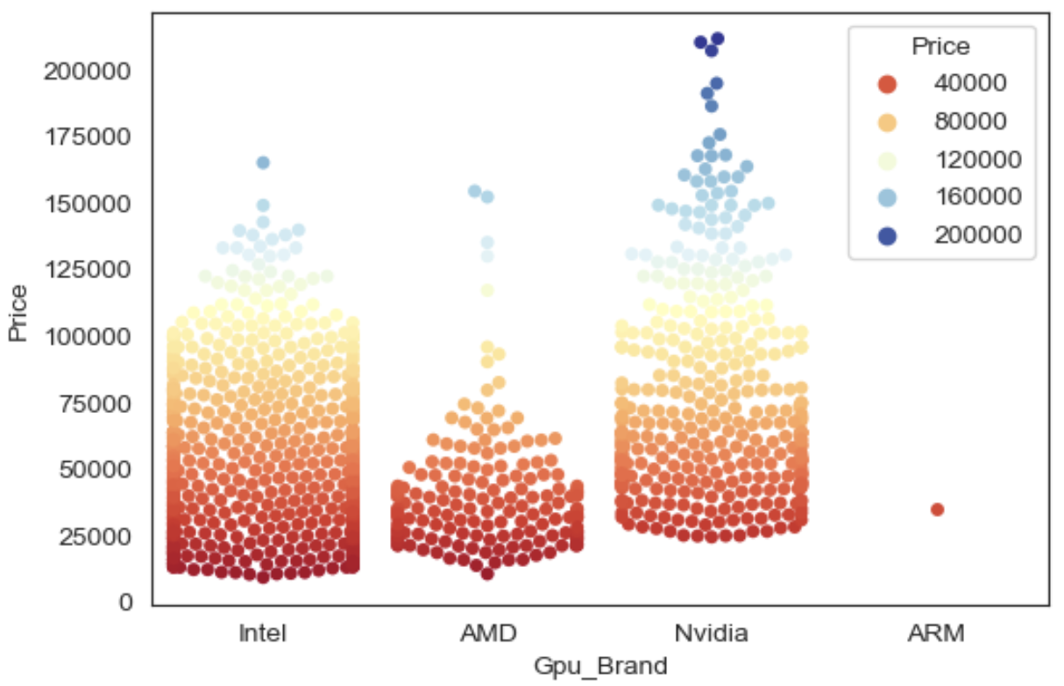
Exploratory Data Analysis
Notes:
Although Intel's price is much higher than the other two brands, Intel's market share reaches 95%, occupying an absolute dominant position. The fundamental reason is that Intel's CPU processor is very powerful in functionality and is far ahead of other brands. When the performance of a product can occupy a leading position that no one can surpass in the market, the market will no longer be sensitive to price because there are no other substitute brands.
Nvidia's overall price is higher than other GPU brands, and it has many high-priced laptops. This shows that Nvidia is mainly targeting the specific consumers who is using high-end graphics processor unit.

Slide 10
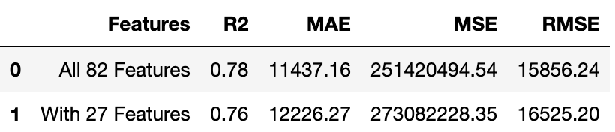
Feature Selection
After Encoding
VIF
RFE
Remove Collinear Features
83 Features
30 Features
28 Features
27 Features
Notes:
The scores after feature selection are not much different from the scores of the original 82 features.

Slide 11
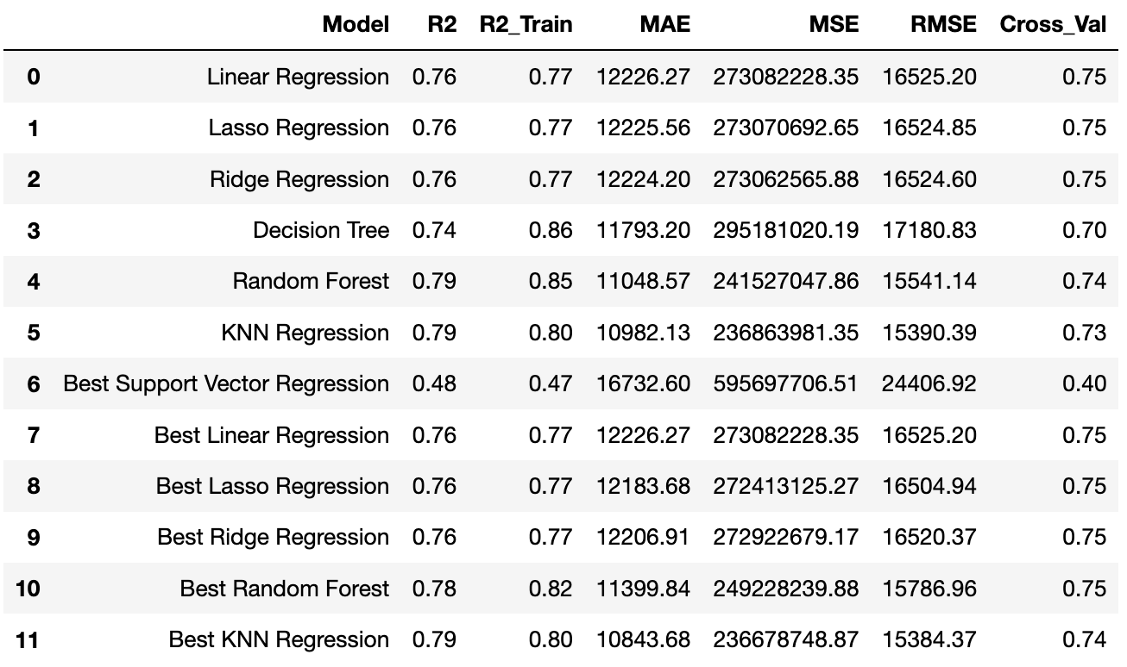
Model Hyperparameter Tuning
Notes:
After model training and tuning, for KNN Regression model
The "Best KNN Regression" model has an R2 value of 0.79, which indicates that approximately 79% of the variance in the target variable is explained by the model.
The Cross-Validation Score is 0.74, which suggests that it maintains good performance across different subsets of the data. This indicates a robust and reliable model.
Considering these metrics collectively, KNN Regression shows a good performance in explanatory ability, prediction accuracy, and stability, making it the optimal choice among the given models.

Slide 12
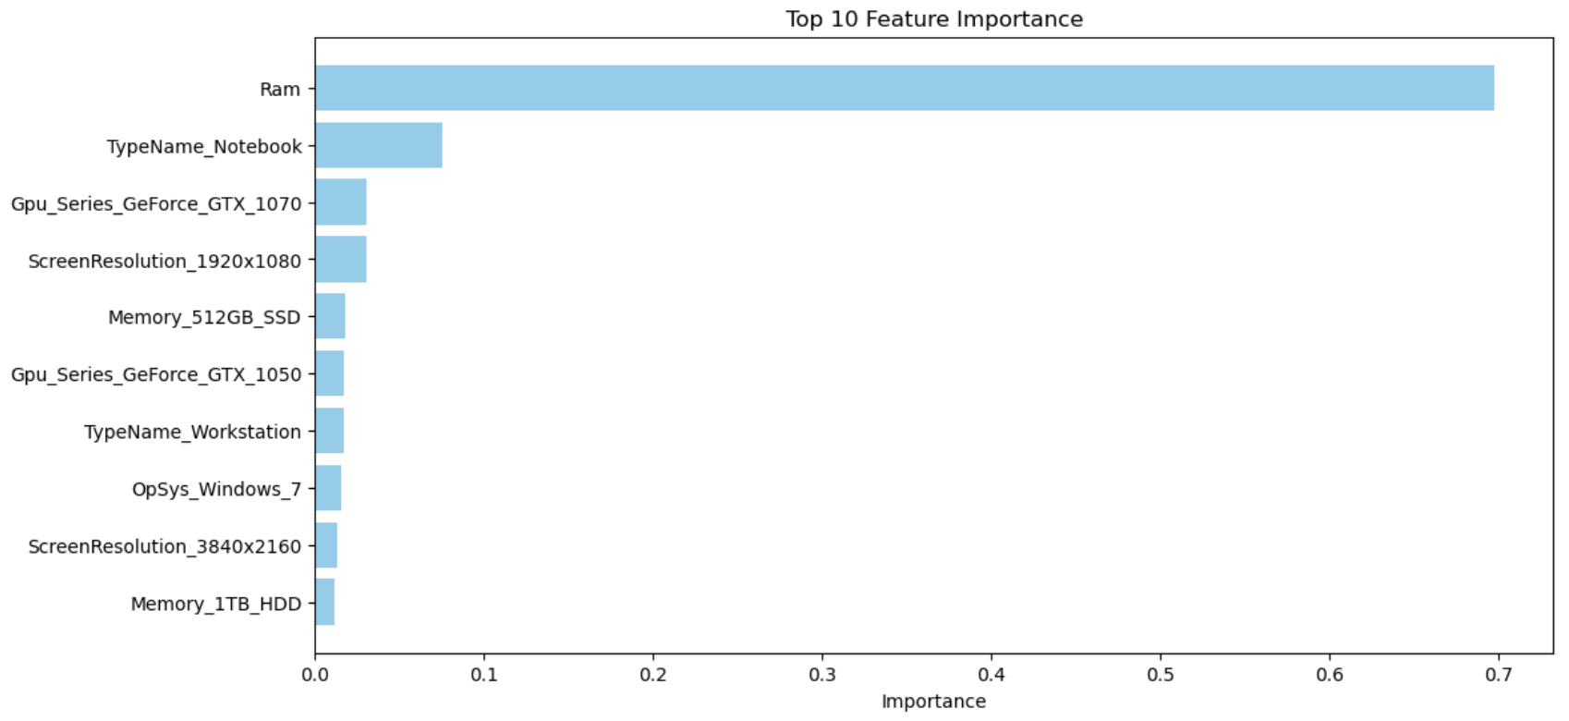
Interpretation & Summary
Notes:
For the Feature importance analysis:
Feature importance reflects the contribution of each feature to the model when predicting laptop price.
According to the top 10 features ranked by feature importance, we can see that Random Access Memory, laptop type, GPU model, screen resolution, have a high impact on laptop prices.
For the Business impact analysis:
RAM, GPU model, screen resolution, laptop type have a greater impact on price, so these factors should be considered when designing products or sales strategies.
For example, when pricing, we need to consider whether the RAM size, GPU model, etc. are high-end, which will affect the product pricing strategy.

Slide 13
Thank You

